Slide 1
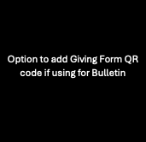
Giving Has Never Been Easier.
You can now give from any of your stored digital wallets from your phone!
Insert Giving Url Here.

